Slide 1


Pearler. Social Timeline Team 2

Slide 2


Pearler.
Social
Social
UNSW ChallENG Program
Maker Games
Pearler. Social Timeline - Team 2

Slide 3

Stock Trading
Technology Advancement
19th Century
Stock Certificate - Paper
1930s
Physical Trading - Telephone
1970s
Electronic Trading - Computers
Now
Mobile application (Pearler. Commsec, Etoro)

Slide 4
Communication
Sharing Information
In Person
Face-to-face
Limited Distance
Telephone, Mails, Fax
Global
Internet

Slide 5
Communication
Personal Information
In Person
Face-to-face
Limited Distance
Telephone, Mails, Fax
Global
Internet

Slide 6

Problem
Global Communication
Communication
1
Platform, Misinformation, Community
Security
2
Fraud, Security breach
Privacy
3
Sensitive information

Slide 7
Social
A Social Media Platform dedicated for personal finance and investment

Slide 8






Pearler. Social
Features
Popular Features
New Features
Facebook
Instagram
LinkedIn
Pearler.

Slide 9
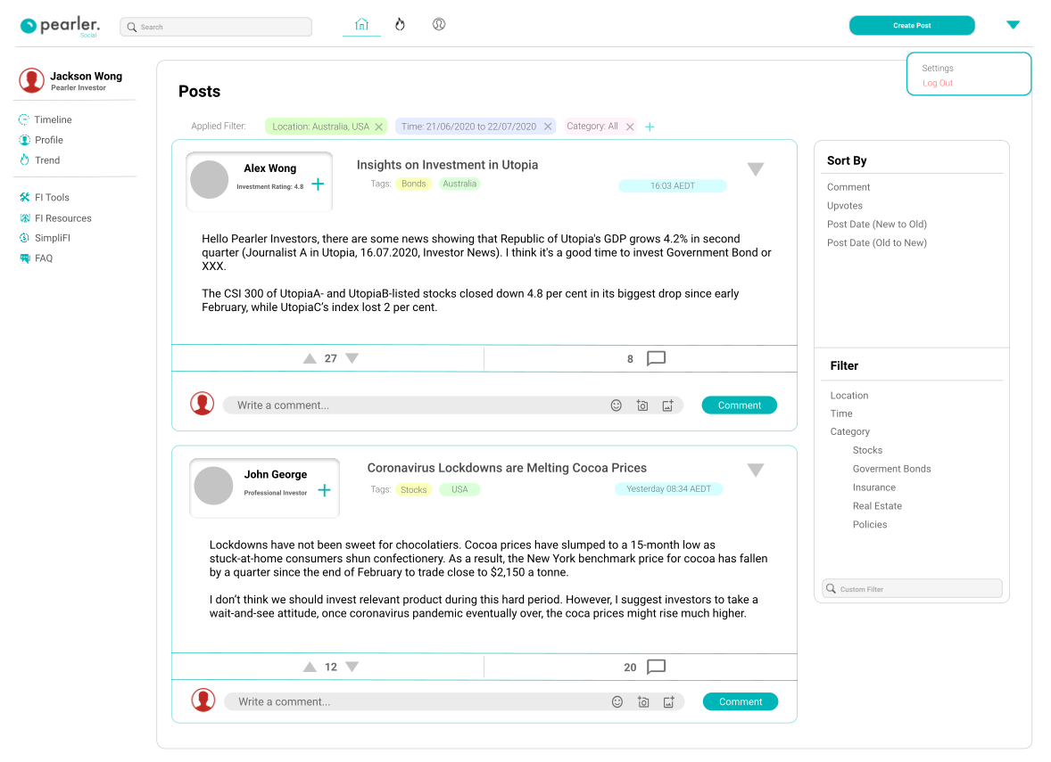
Solution
Main Page

Slide 10
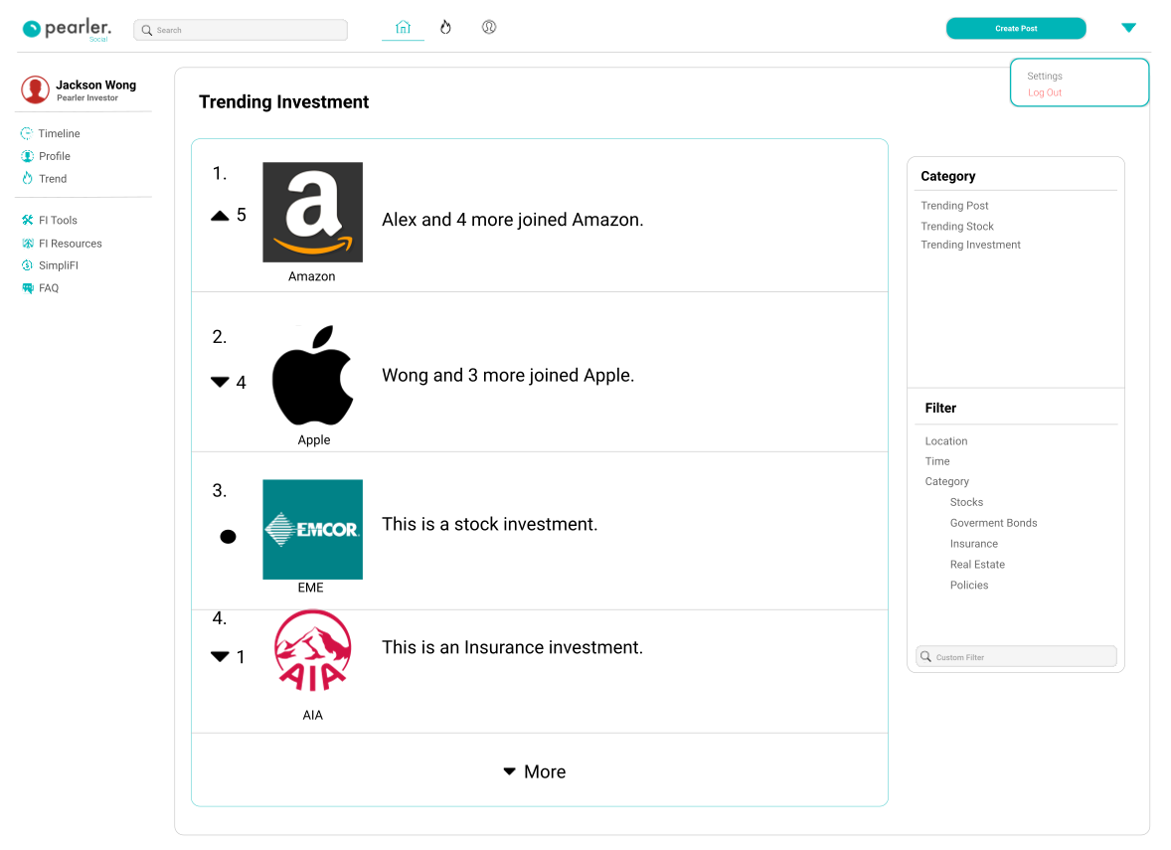
Solution
Investment Trending Page

Slide 11
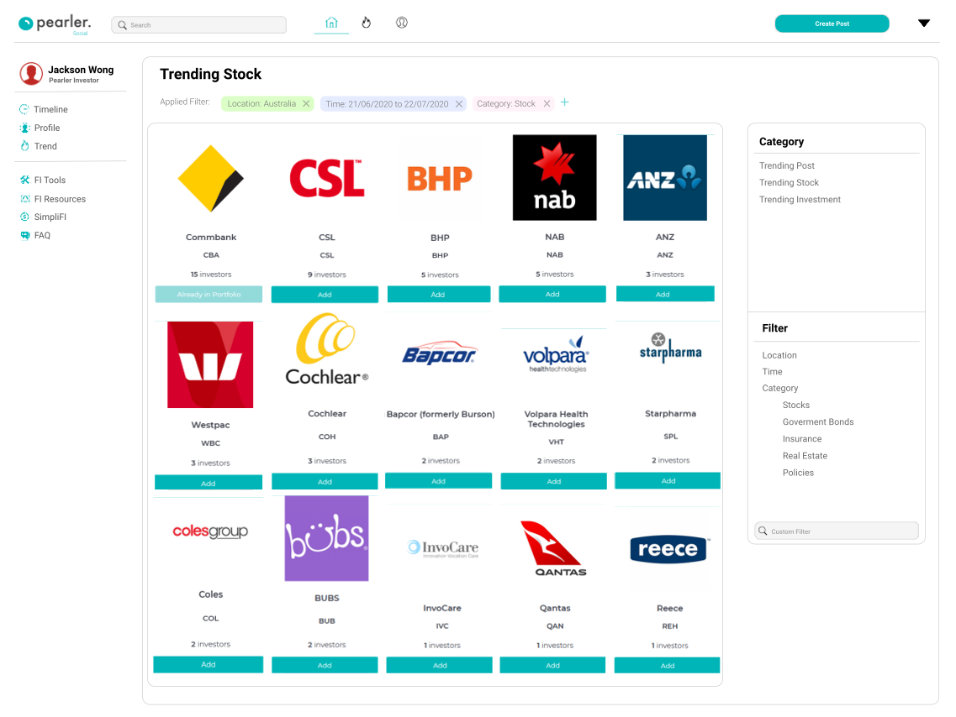
Solution
Stock Trending Page

Slide 12
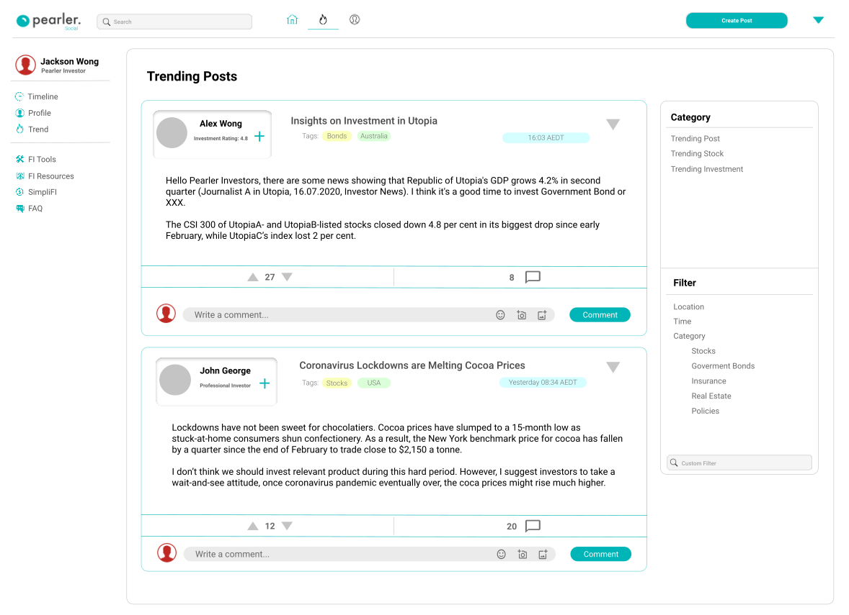
Solution
Trending Post Page

Slide 13
Solution
Trending Post Page
Communication
1
Specialised social media
Security
2
Social media guideline & rules
Privacy
3
Unique Rating System

Slide 14

Revenue Stream
Pearler. Social
Pearler. Social
Advertisement

Slide 15

Social
Social Platform dedicated for personal finance and investment
Best Low Cost Online Broker

Slide 16
A Community for Personal Finance

Slide 17




Member
Pearler Social
Kit Fu
Team Lead
Software Engineering / Psychology
Vincent Shi
Team Lead
Software Engineering
Wincent Winarko
Team Member
Computer Science
Trina Chang
Team Member
Electrical Engineering / Computer Science

Slide 18
COMMUNICATION START
Page 7: page for multiple market analysis, and survey to customers. we combine the features from Facebook, instagram and LinkedIn
This page would be showing the major social platform (icons from these)
Page 8: Main page: In terms of communication, able to interact with other users such as making comment upvoting post
Page 9: Monitor market trend, check stock trend and so on
Page 10: see other investors profile and see their achievements, previous posts(investment insights)
COMMUNICATION END
SECURITY START
Page 11: In terms of security, we have a comprehensive guideline for posts. ----- Prevent misinformation (change the figma prototype)
Page 12: Unique rating system which combine user performance data so user can use the information as a guideline
SECURITY END
PRIVACY START
Page 12: In terms of privacy, Unique rating system, would not share actual figures, we have our algorithms calculating these scores so the overall investment prograss is transparent for other users.
PRIVACY END
Page 13: Summary: how we solved these problem ... and much more () similar to apple's much more(with features)
Page 14: Conclusion: market shares, user that we estimate to attract, profit (we calculated all the cost form bluh 50% profit margin)
page 15: we are not just creating a social platform ,by combining pearler and pearler social, we are creating a community for styudents, and poeple ....

Slide 19
Stock Trading
Technology Advancement
19th Century
Stock Certificate - Paper
1930s
Physical Trading - Telephone
1970s
Electronic Trading - Computers
Now
Mobile application (Pearler. Commsec, Etoro)

Slide 20
Communication
Sharing Information
In Person
Face-to-face
Limited Distance
Telephone, Mails, Fax
Global
Internet

Slide 21
Communication
Personal Information
In Person
Face-to-face
Limited Distance
Telephone, Mails, Fax
Global
Internet

Slide 22
Problem
Global Communication
Communication
1
Platform, Misinformation, Community
Security
2
Fraud, Security breach
Privacy
3
Sensitive information

Slide 23
Social
A Social Media Platform dedicated for personal finance and investment

Slide 25
Pearler. Social
Features
Popular Features
New Features
Facebook
Instagram
LinkedIn
Pearler.

Slide 26
Solution
Main Page

Slide 27
Solution
Investment Trending Page

Slide 28
Solution
Stock Trending Page

Slide 29
Solution
Trending Post Page

Slide 30
Solution
Trending Post Page
Communication
1
Specialised social media
Security
2
Social media guideline & rules
Privacy
3
Unique Rating System

Slide 31
Revenue Stream
Pearler Social
Pearler. Social
Advertisement

Slide 32
Social
Social Platform dedicated for personal finance and investment
Best Low Cost Online Broker

Slide 33
A Community for Personal Finance

Slide 34
Member
Pearler Social
Kit Fu
Team Lead
Software Engineering / Psychology
Vincent Shi
Team Lead
Software Engineering
Wincent Winarko
Team Member
Computer Science
Trina Chang
Team Member
Electrical Engineering / Computer Science

Slide 35
COMMUNICATION START
Page 7: page for multiple market analysis, and survey to customers. we combine the features from Facebook, instagram and LinkedIn
This page would be showing the major social platform (icons from these)
Page 8: Main page: In terms of communication, able to interact with other users such as making comment upvoting post
Page 9: Monitor market trend, check stock trend and so on
Page 10: see other investors profile and see their achievements, previous posts(investment insights)
COMMUNICATION END
SECURITY START
Page 11: In terms of security, we have a comprehensive guideline for posts. ----- Prevent misinformation (change the figma prototype)
Page 12: Unique rating system which combine user performance data so user can use the information as a guideline
SECURITY END
PRIVACY START
Page 12: In terms of privacy, Unique rating system, would not share actual figures, we have our algorithms calculating these scores so the overall investment prograss is transparent for other users.
PRIVACY END
Page 13: Summary: how we solved these problem ... and much more () similar to apple's much more(with features)
Page 14: Conclusion: market shares, user that we estimate to attract, profit (we calculated all the cost form bluh 50% profit margin)
page 15: we are not just creating a social platform ,by combining pearler and pearler social, we are creating a community for styudents, and poeple ....

Slide 36
Thank You
CRICOS Provider Code 00098G

